Slide 1
Moving Students Between PAN Sessions
For Computer-Based Testing
Notes:
Welcome to the Moving Students Between PAN Sessions training slides.
These training slides detail the steps to move students from one PearsonAccess Next (PAN) Session to another for computer-based testing. This module is not applicable for schools doing only paper-based testing.

Slide 2
How to use this PowerPoint
Additional information is included in the Notes section of most slides.
Some slides in this PowerPoint have videos. When this occurs, it will be mentioned in the Notes section.
  When a video is available, please hover your cursor over the slide and select the Play button to view the video.
  For slides with videos, please remember to read the Notes section for additional information.

Slide 3
Glossary
PearsonAccess^{next} (PAN): The online management system. All schools will use PAN to register students and order test materials. PAN is also used to manage testing activities for computer-based testing.
PAN Session: A group of students in PearsonAccess^{next} assigned the same subject and grade computer-based test who will take the test at the same time and in the same testing location.

Slide 4
Moving Students
  The most common reasons to move a student from one PAN Session to another include the following:
  Correcting an error in the PAN Session to which the student was initially assigned
  Updating a student’s PAN Session
  Moving a newly enrolled student during the enrollment transfer process
  (Optional) Moving a student who was absent during testing to be in a new PAN Session for make-up testing
Notes:
Note that you cannot move students who are in Active status, or who are in a Session that is stopped.
Test Coordinators should also know how to create PAN Sessions. A Creating Sessions module with step-by-step instructions is available on the MCAS Resource Center at http://mcas.pearsonsupport.com/training/

Slide 5
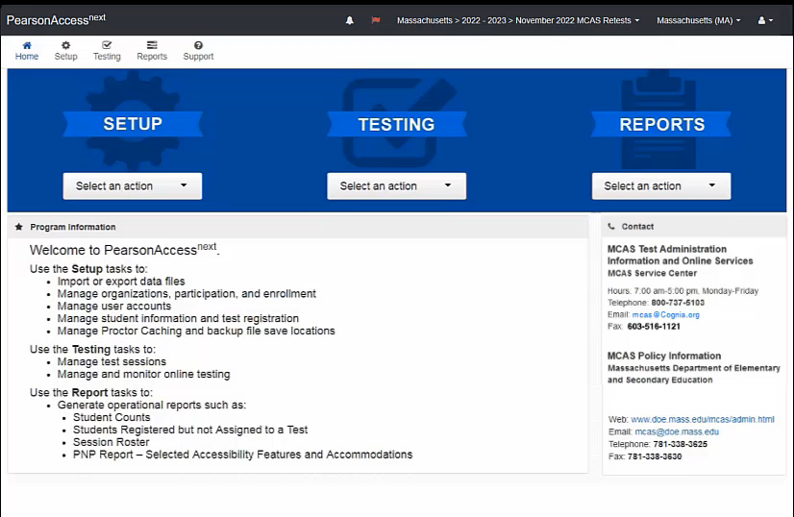
How to Move Students
Notes:
Please select the play button above to view the video.
In order to move a student to a new PearsonAccess^{next} Session, the test assigned to the Session must match the test assigned to the student.
To move a student into a Session that has already been created, first navigate to Testing > Sessions and check the boxes next to the current Session as well as the Session into which the student will be moved. Then go to Testing > Students in Sessions. Click the current Session on the left-hand side of the screen, scroll down, and check the box next to the student(s).
Click Select Tasks, then check Move Students between Sessions, and then click Start.
On this page, check the box under the name of the new PearsonAccess^{next} Session, then click Move.
To move a student into a new Session in PearsonAccess^{next}, first you will need to create a new Session by clicking the button for Create Session, which is also on this page. Then fill out the details for the new Session, and then click Create. You will then see the new Session listed on this page and can check the box under the Session name to move the student.

Slide 6
Resources
PearsonAccess Next User Guide – Move a Student Test Between Sessions (URL: https://support.assessment.pearson.com/x/oQAHAQ)
Notes:
You may use this resource to help with the process.

Slide 7
Thank you.
Thank you.
Notes:
This concludes the Moving Students Between Sessions training slides. Thank you.

